Slide 1
Pharmacy Benefit Savings Study for the FELRA & UFCW
Health & Welfare Fund
July 18, 2014
Nancy Eid, Principal Pharmacy Advisor
Nancy@ConsultHeritageRx.com; tel 612.281.9195

Slide 2
Agenda
Study analysis and methodology
Data Sources
  2013 FELRA Fund Utilization and Cost Trends
  Safeway Health
View of the Savings, Member Impact
Recommendations
Next Steps

Slide 3
Savings Analysis & Results
> 120 Days
UM Programs
Managed Formulary
Savings: $3,186,996 Annualized
Competitive Bidding
Reference Pricing
CheckRx
New Contract Savings: $1.5M - $2.1M annually for each year of the agreement
Medical Specialty Program
Integrated Medical Management
Savings Est. 7-10% total annual specialty (med/rx)
90-120 Days
30-90 Days

Slide 4
30-90 Day Solutions
Utilization Management Programs:
  Fraud, Waste & Abuse
  Compounds
Managed Formulary

Slide 5
High Value, High Impact
 | Fraud, Waste & Abuse | Compound Exclusions | Managed Formulary
Description | Retrospective claims review using >300 algorithms to detect fraud, waste & abuse at prescriber, member, pharmacy level; focus on controlled substances. | 25 compound powders excluded from coverage at POS. Industry wide trend to exclude most or all compound medications due to availability of legend alternatives; safety; costs; FDA. | National Preferred Closed High Performance Formulary
Outcomes | Mitigate risk, cost reduction & avoidance, quality of care. | Cost reduction, quality control, safety, FDA compliance. | Cost reduction, clinical safety & coverage
Intervention | Monitor, investigate, intervene at prescriber, member &/or pharmacy level. Discreet & direct interventions based on findings (i.e. block DEA#; limit dispensing to one pharmacy) | Custom letters sent to members 60 days prior to exclusions with list of prescriber alternatives. | NPC: Third Tier Medications Excluded; all therapy classes covered by lower cost generic or therapy equivalents in tiers 1 & 2. HPF: Generics based formulary; comprehensive therapy class coverage – all tiers
Implementation | 30 Days or Less | 60 Days | 90 Days
Annualized Savings | $165,000 - $250,000 | $760,760 | NPC: $1,664,788 HPF: $2,176,236
Member Impact | 126 at risk (39 moderate risk) | 270 | Non Preferred Closed Members: 545 Rxs 557 High Performance Formulary Members 3669 Rxs 4490

Slide 6
90-120 Day Solutions
Competitive Bid
Reference Base Pricing
CheckRx

Slide 7
Competitive Bidding
Vendor Solicitation Recommendations
  Catamaran
  CVS/Caremark
  EnvisionRx
  Express Scripts
  Navitus
  OptumRx

Slide 8
Competitive Bidding
Vendor Solicitation Recommendations
  Catamaran
  CVS/Caremark
  EnvisionRx
  Express Scripts
  Navitus
  OptumRx

Slide 9
RFP - Qualitative Assessment
Mandatory Requirements | Minimum Requirements |  | Performance Guarantees
Annual Price Guarantees | Account Management | Payment Terms | Account Management
Audit Transparency | Annual Guarantees ($ for $) | PPACA Guidance/Support | Claims Payment Accuracy
Custom Program Admin | Benefits Administration | Rebate Payment & Reporting | Customer Service
Definitions (Contract) | Claims Administration | Trend Reporting & Forecasts | Eligibility Admin
Market Check | CMS Program Admin | Web-based Consumer Tools | Implementation
Participating Network Admin | Communications |  | Invoicing Accuracy
Reference Base Pricing | DUR Program Mgt |  | Network Management
Term and Termination Rights | Member Services |  | Plan Design Administration
Unbundled Services | Medicare Part D Admin |  | Reporting

Slide 10
RFP - Financial Assessment
Discounts, Disp. Fees, Rebates | Program Admin Fees | Credits/Offsets
Cost Plus Pricing | Custom Communications Design | Annual Performance Guarantees
Reference Pricing | Claims Administration | Implementation
Traditional Pricing | Network Audit | Pharmacy Management Fund
Retail 30 Discounts & Dispensing Fees | Per Claim Admin Fee | Others TBD
Retail 90 Discounts & Dispensing Fees | Postal Charges/Mailing
Retail Rebates | Prior Authorization Administration
Specialty Discounts & Dispensing Fees | Programming Fees

Slide 11
Vendor Selection Scorecard
Criteria | Weight | Catamaran | CVS/ Caremark | EnvisionRx | ESI | Navitus | OptumRx
Audit Transparency
Account Services/ Implementation
Consumer Tools
Contract Administration
Operational Performance Guarantees
Total Financial Package
Raw Score
Weighted Average/Rank
Scoring Key
0= Does not meet FELRA/Industry Standards
3= Meets FELRA/Industry Standards
5= Exceeds/Industry Standards

Slide 12
90-120 Day Solutions
Safeway Health™
RxTE® Market Price Drug Program

Slide 13
Background - Reference Pricing
Plan Adoption - estimated adoption levels by the nation’s largest employers ~ 12% in 2013, primarily for imaging, surgical procedures and drugs
Program Administration - Castlight Health has been on the forefront of web-based consumer transparency tools; Safeway Health has lead the development of reference base pricing programs and services
Pharmacy Benefits Managers (PBMs) - EnvisionRx is the early adopter among carve-out PBMs; Catamaran & Caremark administer a small number of RBP plans

Slide 14
Reference Drug Pricing
Reduces the plan’s exposure through price-based, therapy class coverage limitations
  members choosing the higher cost therapy(ies) pay the full cost difference between the reference vs alternative medication
  Covers

Slide 15
Safeway Health Model
Three (3) year Management Agreement
  Term Penalty for early exit
  Proprietary rights to the reference pricing algorithms
  Limits of Liability & Indemnification Clauses protect Safeway Health against adverse financial or member outcomes
Fees
  PEPM Fee with savings guarantees; template contract indicates 10% from ‘current’
  GDR targets

Slide 16
Safeway Health Model
Services
  Savings analysis and initial design, reference price recommendations
  Co-manages implementation with PBM, including prescriber, member outreach
  Ongoing program monitoring with semi-annual recommendations

Slide 17
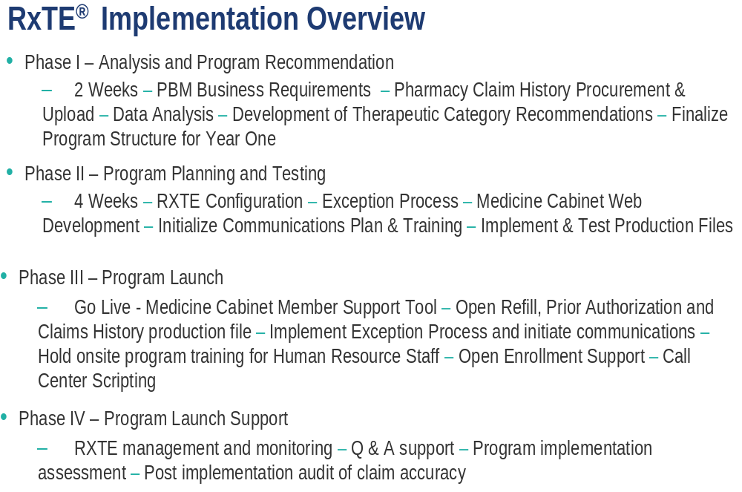
Installation 90 – 180 Days¹
¹Timeline varies by PBM and Plan
Source: Safeway Health 2014

Slide 18
Key Considerations & Risks
Reference Pricing
Managed Formulary
Considerations
  Program maintenance
  Prescriber and member appeals
  Administrative costs
  Professional support required
Risks:
  Portability
  Vendor and program administration experience
  Specialty pharmacy requires separate solution
Considerations
  Rebate loss vs low cost, high value formulary options
  Medical necessity criteria maintained for exclusions
  Member support, communications
Risks:
  Managing new therapies, new indications
  Specialty pharmacy requires separate solution
  Conflicts with PBM’s formulary exclusions

Slide 19
Safeway Health Model
Three (3) year Management Agreement
  Term Penalty for early exit
  Proprietary rights to the reference pricing algorithms
  Limits of Liability & Indemnification Clauses protect Safeway Health against adverse financial or member outcomes
Fees
  PEPM Fee with savings guarantees; template contract indicates 10% from ‘current’
  GDR targets

Slide 20
Recommendations

Slide 21
Incremental Value, Savings
Compounds
FWA
Managed Formulary
Competitive Bidding
Reference Pricing
Check Rx
Medical Specialty Program

Slide 22
Other Programs Reviewed
Advanced Utilization Management Package
Pharmacogenomics PA

Slide 23
Programs Considered
Advanced UM Program
Bundled package of ST, PA, QLL programs spanning legacy ESI/Medco
3-tier acuity level interventions:
  Step Therapy includes product switches to higher AWP, rebateable brands/MSBs
  PA Program lacks evidence of efficacy (>94% or higher approval)
  Significant savings attributable to inferred medical (cost avoidance)
Maximum Member Impact: 8878
Program Cost: $.80 PMPM
Maximum Plan Savings: $2.975,294
Recommendation: Decline Participation
Probability of actual savings before 12 months – low, due to offset from grandfathering, appeals and admin charges. Program stability and sustainable savings poor after year 1, due to preferred drugs losing patent, higher than average inflation on MSBs, annual changes to PBM rebate contracts.
Pharmacogenomics Prior Auth
Genomic testing for efficacy of HepC treatments
Treatment stopped at point of sale, prescriber PA requires:
  Genetic testing when available
  Utilization review – treatment guidelines, dosing, patient treatment protocols
Member Impact: 13
Program Cost: $.05 PMPM
Net Plan Savings: $130,000
Recommendation: Decline Participation
Lack of evidence proving outcomes result from ESI intervention vs regression to the mean. Genetic testing highly controversial (HepC reporting mandates). Rebates earned from testing, preferred drug retained by PBM. HepC treatments tightly controlled by FDA, manufacturers, materially reducing the risk of over- or under-utilization of therapies.
Plan Savings based on 2013 utilization

